Slide 1
7-Eleven Cloud Migration – Case Study

Slide 2


Single Slider View
Purpose
Audience
Cognizant Internal Circulation
Senior Management, BU repository, SGO & SPG Teams

Slide 3





Digital transformation by migrating Large and complex on-premise workload to Azure Cloud
Program Back Ground
Out Come Delivered
7-Eleven’s one of the key strategic initiatives in 2018-2020 was to significantly reduce the Data center footprint and move to the cloud (Data Center migration to Azure) in order to meet achieve their digital transformation goals and significantly reduce the hosting spend with a vision of:
35% reduction in TCO
Operational cost savings of nearly $5M within 2 years
Provide agility to digital business by 85% faster provisioning
Reduce year on year operational and maintenance cost
Reduce spend on OS upgrades in bits and pieces for application stability
All major lines of business migrated successfully with minimum to 0 disruptions
Achieve faster infrastructure provisioning
Digital Enablement through DevOps, Micro services and containerization
Infinite capacity at a Click through Infrastructure automation
Seamless migration of the Data Centers
13 Biz SLAs and no impact on any one
Software Defined Infrastructure through Auto infrastructure upgrades
Operational Excellence through Automated System recovery
Cognizant did a proactive assessment and was selected to do the Migration over incumbent
Readiness to next level Cloud Computing
Shift from IaaS to PaaS and SaaS
Micro services and containerization enablement
Existing Data Centers and Way ahead:
Current Data centers in Omaha, Cypress Water and Allen
Client Objective - Remove Omaha and Allen. And move to Azure (primarily) and to Cypress Water (Azure Stack – Private Cloud)
Notes:
RAJAN

Slide 4
Detailed Case Study
Purpose
Audience
Cognizant Internal Circulation
Senior Management, BU repository, SGO & SPG Teams

Slide 5





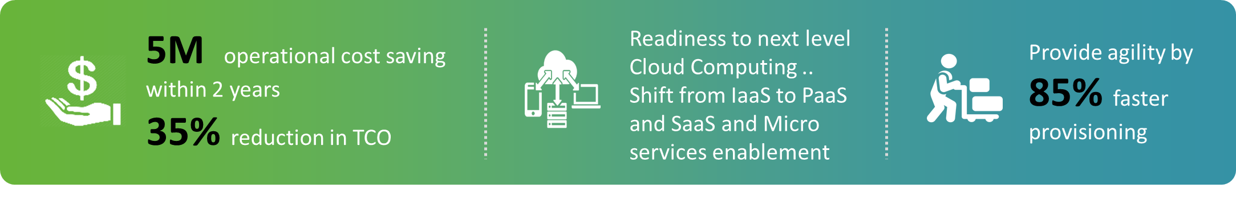
Client Over view, Program Objective and Success delivered
Client Over view
Program Background
7-Eleven’s one of the key strategic initiatives in 2018-2020 was to significantly reduce the Data center footprint and move to the cloud (Data Center migration to Azure) in order to meet achieve their digital transformation goals and significantly reduce the hosting spend (OpEx and CapEx).
World’s largest convenience Store chain
15 Countries
69,000 Stores
11,800 Stores in North America
(US & Canada)
$4.61 B USD
revenue
In 2018, 7-Eleven .started its modernization Journey with Movement to Azure Cloud
Existing Data Centers and Way ahead:
Current Data centers in Omaha, Cypress Water and Allen
Client Objective - Remove Omaha and Allen. Move to Azure (primarily) and to Cypress Water (Azure Stack – Private Cloud)
Outcome delivered

Slide 6
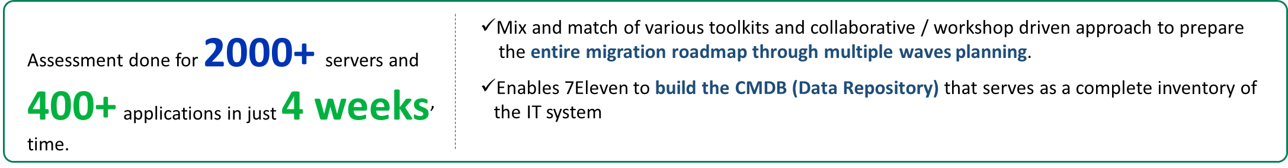

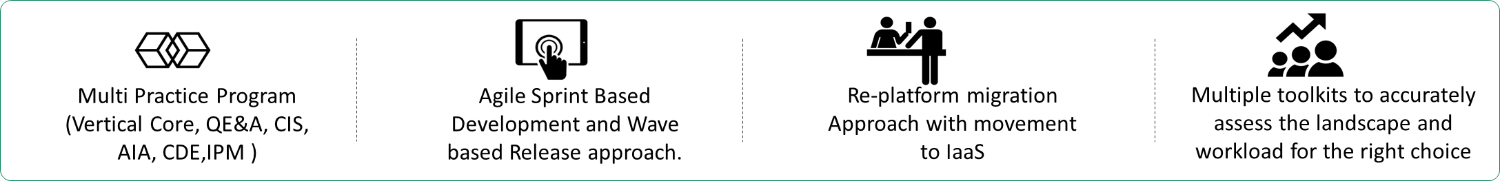
Initiation, Scope, Technology and Delivery
How we started
Proactive proposition
Scope of Migration
Migration Approach
Tech Stack
This involves migration of multiple technologies (.Net, Java, C/Unix, Perl, Cobol, Sharepoint/O365), multiple databases (SQL, Oracle and Access) and multiple platforms (Windows, UNIX and Linux) and many COTS products to Azure, leveraging latest Azure offerings like Azure stack, managed instance and other solutions.
Delivery Tenants

Slide 7
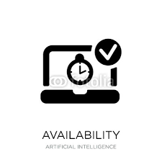


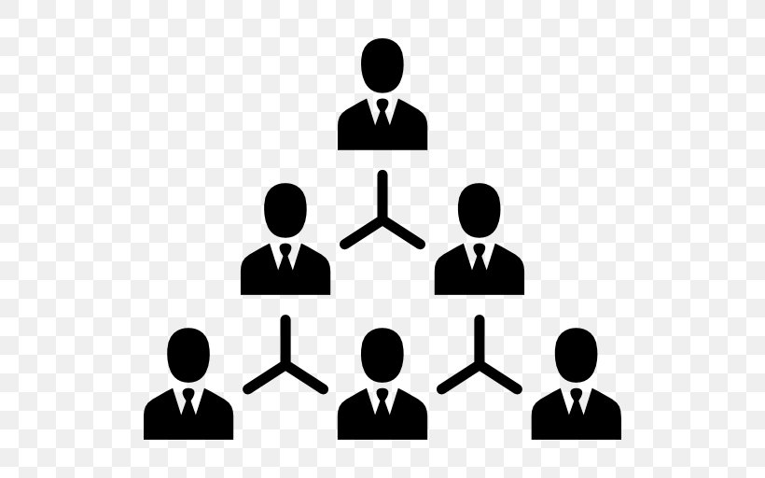
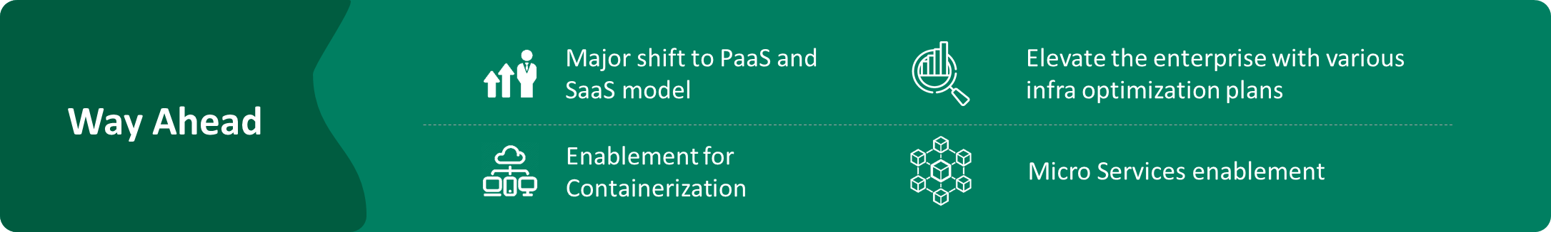
Challenges, Overcoming and Way forwards
Delivery Challenges
High Availability and Continuous Change
Organizational
Unprecedented
Covid-19
Tightly Coupled System
Heavily customized and interlinked applications constraining the release schedule and hybrid model planning
Multi-cloud environment in interdependent application and database suite
One of the most critical releases by setting up virtual war rooms with nearly 80 participants and deploying nearly 52 applications together in just 4 and ½ hours window
Minimal downtime for application/COTS releases
Continual on-going developments in all the areas giving minimal code freeze time
Multiple leadership changes
Budget cuts
Strategy changes
Overcoming those By
Multiple Proof of Concepts
Innovative approaches
Minimal down time planning
Grouped migration wave planning
Dev and Ops work for one goal
Well handled intersystem dependencies
Multiple load testing
Multiple Mock migrations
Robust run book for release resiliency

Slide 8




What we achieved..
Current Status
Quality Of Service
Benefit To 7-Eleven
Helping 7-Eleven
Major lines of business migrated successfully with minimum to 0 disruptions :
Store facing and store development
Asset Protection and Planning
Accounting and Financial operations
Store Order Management
Gasoline
Merchandising and Logistics
Configuration and Release Management
8900 stores
3000+ end points / interfaces
1000 servers decommission from current data centers
0% Biz SLA impact
1 – 3% Post shipment defects
Just 2 rollback and immediate comeback with a successful release
0 customer escalation in multi-year journey
Year on year operational & maintenance cost reduction
Reduce unnecessary spend on OS upgrades in bits and pieces to attain application stability
Reduce the threat of security vulnerabilities
Business Resiliency
Digital Enablement
Infinite capacity at a Click
Software Defined Infrastructure
Operational Excellence
Helped 7-Eleven to adapt to the right strategy in many occasions through executing multiple POCs
Since all critical applications could not go live due to multiple project Dependency, TEST servers were made available in Azure to optimize Infra Cost
To mitigate budget constraint a High Risk and High Critical Big Bang release was managed with utmost complexity of team collaboration under Covid-19 situation
46.3%
0.2%
75%
14%
Effort Over Run
Post Shipment Defect
Successful Milestone Completion
Customer Escalations
Delivery
PTD CP
T&E
Offshoring
ELT%
0%
1 - 3%
90%
0%

Slide 9

Voice of Customer
I want to take this moment and recognize an outstanding performance provided by Cognizant team this year on the cloud migration project. Overall, the Cognizant team has done a remarkable job in pulling all the stops in getting the applications to the cloud. I want to appreciate not only their technical expertise but the leadership and professionalism they have demonstrated that is expected from a consulting vendor. Team Cognizant has gone above and beyond in fulfilling the migration requirements to keep the timeline moving. In a few cases even it was clearly outside their SOW.
Things like
Ability to add more applications to the timeline than previously anticipated
Ability to move applications (and corresponding expertise) around to fit the business needs
Ability to staff ad-hoc resources at no charge to alleviate the pressure from the staffed team
Empowering offshore teams to pick up additional responsibilities during business validation meetings
Pro-actively identifying architecture gaps in server topology as well as network to avoid potential disasters
I want to extend my sincere thanks to all the cloud migration and the supporting Cognizant resources for being very open, and optimistic about the tasks at hand. I want to also thank them for continuously demonstrating almost all the leadership principles handed down by 7-eleven corporate. I am very fortunate and honored to have great individuals from Cognizant as part of the cloud migration team. I can summarize some of the highlights of their achievements
…………………..
Not a single failed migration
Imitate remediation of post-deployment issues with zero interruptions
Zero rollbacks
Innovation of grouped migrations (due to tightly coupled system)
Multiple Proof of Concepts (side projects to prove out a theory)
- Sanjay Date : Sr. Program Manager, Infrastructure and Operations
I wish to thank the entire cognizant team for diligently staying on top of the project for nearly 2 years and finally getting all NON-Oracle apps to Azure successfully.
Overall Highlights:
A massive rollout with minimum disruptions
Multi-year engagements with several schedule and delivery adjustments due to technical, business and financial constraints
Multiple business SLAs involved with virtually no impact on a single one
Several applications had sub components making them very complex not just lift and shift type operations
Extensive testing with all supported browsers to test for latency, user login, access privilege issues
Seamless rollout within the planned time and flawless execution
- Sanjay Date : Sr. Program Manager, Infrastructure and Operations
The Cloud Migration project was probably one of the longest, most complicated projects I’ve been party to. Ups & downs, lefts & rights … massive changes during the project (multiple leadership changes, budget cuts, strategy changes, Covid-19, etc.)
It takes quite a team and leadership to persevere through this and come out with a successful migration, with very minimal disruption or issues.
Kudos to the Cognizant team & Sanjay for making this happen!
- Troy Washburn : Director, Infrastructure and Operations

Slide 10
Client Facing Case Study
Purpose
Audience
Cognizant Internal Circulation
Prospects, Clients and Cognizant Internal

Slide 11








Digital transformation - Migrating Large and Complex on-premise workload to Azure
About
the Client
World’s largest convenience Store chain . Spans across 15 Countries with 69,000 Stores. 11,800 stores in North
America.
About
the Project
Start the Digital transformation by migrating 1,000+ servers, 123 applications across 2 large data centers to
Azure Cloud
Project Duration:
Total 2 years - Currently
1.75 year into engagement
7-Eleven’s one of the key strategic initiatives in 2018-2020 was to significantly reduce the Data center footprint and move to the cloud (Data Center migration to Azure) in order to meet achieve their digital transformation goals and significantly reduce the hosting spend (OpEx and CapEx).
Existing Data Centers and Way ahead:
Current Data centers in Omaha, Cypress Water and Allen
Client Objective - Remove Omaha and Alen . And move to Azure (primarily) and to OCI and Cypress Water (Azure Stack – Private Cloud)
Business Need
Peak Team Size:
30
Use of MAP, vROPS, Turbonimics and VRNI for assessing the landscape
Minimal Down Time Deployment and grouped migration wave planning
Automation introduced at all possible places to ensure optimal time in migration
Infrastructure Optimization to provide cost efficiency wherever applicable
Multiple POCs to guide 7-Eleven to adopt to the right approach
Build and Implemented a strategy that ensured 7-Eleven uses the full power of Cloud in the business
Robust run book for release resilience
Virtual War rooms with nearly 80 participants (Onsite-offshore) to manage a very critical release of multiple complex service lines Big Bang
Budget:
$ 6 M (2 years)
Fixed Bid
Cognizant’s
Approach
Geography:
United States
Tools & Technology:
Migration of multiple technologies (.NET, Java, C/Unix, Perl, Cobol, SharePoint/O365),
Multiple databases (SQL, Oracle and Access) ,
Multiple platforms (Windows, UNIX and Linux) ,
Many COTS products to Azure, leveraging latest Azure offerings like PaaS, Azure stack, managed instance and other solutions
35% reduction in TCO
Operational Cost Savings of $5M within 2 years
Readiness to next level Cloud Computing ..Shift from IaaS to PaaS and SaaS and Micro services enablement
Provide agility to digital business by 85% faster provisioning
Business
Outcome

Slide 12
Thank You

